Slide 1

Project-3-team-5-Data visualization to visually show what the asset conditions of our plant are:

Slide 2
As An Asset Manager - Always Ask & Answer:
What do we own?
Where is it?
What does it do?
What is it supposed to do?
What is its condition?
What is its remnant life?
What did it cost? What revenue does it earn?
What does it cost to keep doing its OEM function?
What alternative/ opportunity do we have?
How do I know all of the above?-Visually Display it

Slide 3
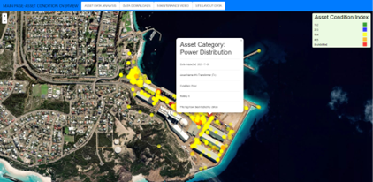


Project-3-team-5-Data visualization Our team will select, analyze, extract, transform, load a dataset and visualize a dashboard and map for SPA state of the asset information: to visually show what the asset conditions of our plant are:
Week 10,11,12, 13,14,15
https://github.com/JohanfromEsperance
https://github.com/vn02063007
Johan
Minh
Southern Ports Datafile
Use ESPERANCE
Filter and Clean in Python
Page 1: Displays asset condition on a rating scale of 1-5
Page 2: Provide detail on the distribution of assets in the various condition states
Page 3 Provide the ability to download the datasets
Page 4: Provide a video training module to allow user to learn about lubrications
Page 5: Provide the ability to identify specific locations
Clean and load to SQL version
FLASK API
BARCHART to WEB page 2
HTML – INDEX
App.js
App.py
CSV Read in, Clean
CSV – JSON
External GEOJSON
LEAFLET
D3.geojson
MARKERS
Marker data setup
See next page
LOAD and READ SQL link
Connect Link to HTML
Upload to WEB Page 2
https://johanfromesperance.github.io/Project-3-DataVisualization/

Slide 4
Project-3-team-5-Data visualization Our team will select, analyze, extract, transform, load a dataset and visualize a dashboard and map for SPA state of the asset information: to visually show what the asset conditions of our plant are:
Data Sources
Review
Inspect
Simulate
E
T
L
V
Exploration and Inspiration
Load
Visualize
Extract
Transform
Locate and download data
SPA- REDUX SAO CSV files
Use JSON and CSV
CLEAN and built JSON file with PYTHON
Prework, structure, common keys, duplicates and NAN
Verify Data formats
Establish MAP and DASHBOARD formats
Design DASHBOARD
LOAD JSON and MAP
Load .CSV to Python and convert
Convert GEOJSON
Check CSV loaded correctly
API endpoints if required for maps
MAP API keys
Wrangling steps
Cleaning – NAN
Filter locations/FORMAT
Align location and usage
Rename headers
Remove columns
Save in SQL
Link FLASK API
Load to PYTHON
Load to WEB
Check and test data
Create and display WEB PAGE
PYTHON
LEAFLET
HTML
JAVA script
SQL
FLASK API
Check and Test Website
Config
CSS
Leaflet
JS
PY
JSON
SQL

Slide 5
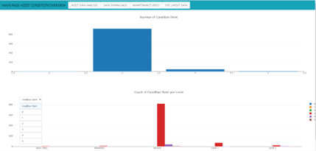
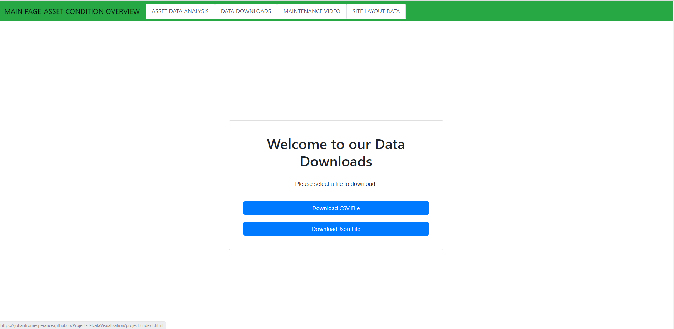
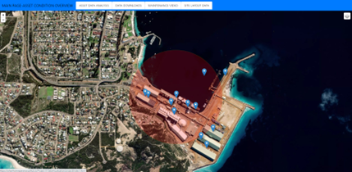
As An Asset Manager - Always Ask & Answer:
What do we own? – Asset Register/Digital E2E/ GIS/TAGS/RFID
Where is it? – SPATIAL Data (GIS)/D365 Attributes
What does it do? – Master Data - AMIS
What is it supposed to do? – Efficiency – LOS - AvXutXRtXUnc
What is its condition? – AI/VISUAL/ML
What is its remnant life? – AI/ML/Degradation/DACMP
What did it cost? What revenue does it earn? ERP-D365SCm F&O
What does it cost to keep doing its OEM function? (GAP) ERP-WOL
What alternative/ opportunity do we have?-Digital Twin/Optioneering
How do I know all of the above? – I hope I answered that question☺

